Slide 1
Core Directors Meeting
Center for Clinical and Translational Science
June 7, 2021

Slide 2
CTSA Program – Ways to Engage

Slide 3
CTSA Program
Objectives of CTSA Program Groups:
Focus on short- and long-term needs with the goal to enable translational science and provide patients with access to treatment more quickly
Provide a structure where measurable objectives of the strategic goals of the CTSA Program can be undertaken
Inclusive process where all hubs can participate and have access
Foster communication and collaboration at all levels
Discrete objectives, timelines and deliverables for every activity
Steering Committee
Enterprise Committees
Discussion Forums
Consortium Committees
Working Groups

Slide 4
CTSA Program Groups
CTSA Program Steering Committee
GROUPS THAT THINK
GROUPS THAT DO
Consortium Groups
(Admins, Comms,
KL2, TL1)
Enterprise Committees
Discussion Forums
Work Groups
Standing Groups
AdHoc Groups

Slide 5
CTSA Enterprise Committees
Promote collaboration and innovation across key areas
Provide an open forum for broad, domain-focused discussions
Discuss and disseminate best practices
May develop plans for projects that fill identified gaps and/or further the program objectives through a work group proposal
Membership requested though CLIC website.
Informatics
Workforce Development
Collaboration & Engagement
Methods & Processes
Lifespan Integration

Slide 6
CTSA Working Groups
Consider and develop solutions around a specific clinical and translational science issue
Defined Working Group Application process, SC approval required
Maximum of 12 active workgroups at any given time
Can be proposed by ECs, discussion forums, hub or pod members, or consortium committees
Well-defined projects or deliverables
No more than 2 years
Active
Adaptive Capacity and Preparedness of CTSA Hubs
Advancing Dissemination and Implementation Sciences in CTSAs
Clinical Research Workload and Study Complexity Assessment
CTSA Visiting Professorship Working Group
Inclusion of Older Adults as a Model for Special Populations
Text Analytics toward Semantic Interoperability and Data Sharing
TL1 Visiting Scientist Working Group
Well-Being Integration Working Group

Slide 7
Sunsetting Working Groups
Community & Collaboration
Assessment of CTSA Institutions Strategies for Engaging Community Partners
Community Member Compensation
Developing Measures for Assessing and Improving Collaborations
Health Disparities
Dissemination, Implementation (D&I) and Knowledge Transfer
Team Science
Institutional Readiness for Team Science
Developing Translational Science Team Competencies
Lifespan
Aging
Early Life Exposures
Life Course Visual Toolkit Development
Evaluation
Measures of Impact
Education & Training
Best Practices for Mentoring and Supporting TL1 and KL2
Clinical Research Training for Investigators
Federated Education Platform: Harmonizing Competencies
Researcher Training and Education and Community Capacity Building
Research Methods
Designing and Analyzing Clinical Trials for Personalized Medicine
Regulatory Science to Advance Precision Medicine
Single Disease
Informatics
Sustainability Phase 2 WG
Sustainable Informatics Infrastructure
Text Analytics and De-Identification
EMR-based Research Recruitment
Enterprise Data Warehouse for Research - Phase 2
Enterprise Data Warehouse Service and Architecture Models
Imaging Informatics

Slide 8
CTSA Discussion Forums
Advance CTSA Program objectives in high priority areas
Discuss more specific, focused topics in depth
May develop plans for projects that fill identified gaps and/or further the program objectives through a work group proposal
Cannot be used to develop a grant application or for discussion of funding.
Requests to establish or join are submitted through CLIC website
Clinical Research Professional Discussion Forum
Community Engagement Discussion Group
CTSA Partnerships with Public Departments of Health & Healthcare
CTSA Program Response to COVID-19 Discussion Forum
NCATS CTSA Program Quality Assurance/Quality Control Group
Precision Medicine Discussion Group (PMDG)
Education & Career Development
Expanded Access Group
IND-IDE Workgroup
Nurses in Translational Research Group
Pharmacy and Research Pharmacy
Research Unit Network (RUN)

Slide 9
Association for Clinical and Translational Science
ACTS offers its members the opportunity to participate in Special Interest Groups (SIGs) related to the field of clinical research and translational science. SIGs connect individuals who share similar goals and interests, providing a channel to network and participate in knowledge and resource sharing among peers.
CCTS has an institutional membership
SIG membership extends beyond just CTSAs to include members from non-CTSA institutions, IDeA Centers, Cancer Centers, etc.
Special Interest Groups
Biostatistics, Epidemiology and Research Design (BERD)
Clinical Research Professional Taskforce (CRPT)
Evaluation
Partners for the Advancement of Community Engaged Research (PACER)
Regulatory Science
Research Education Professionals
Research Operations and Administration
Scholar

Slide 10
CLIC Website

Slide 11
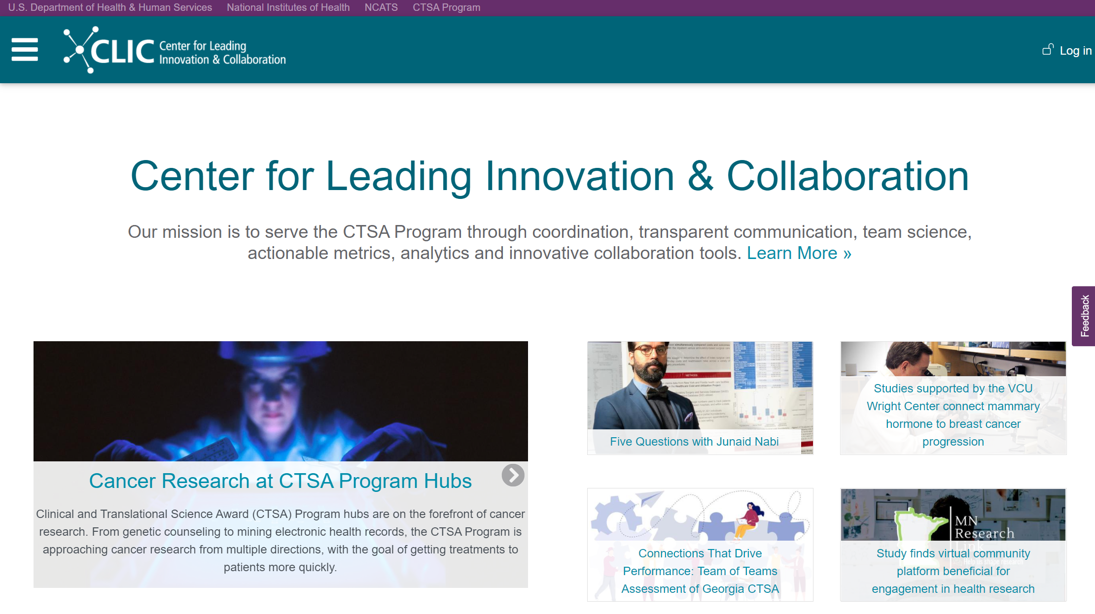
CLIC-CTSA.ORG

Slide 12
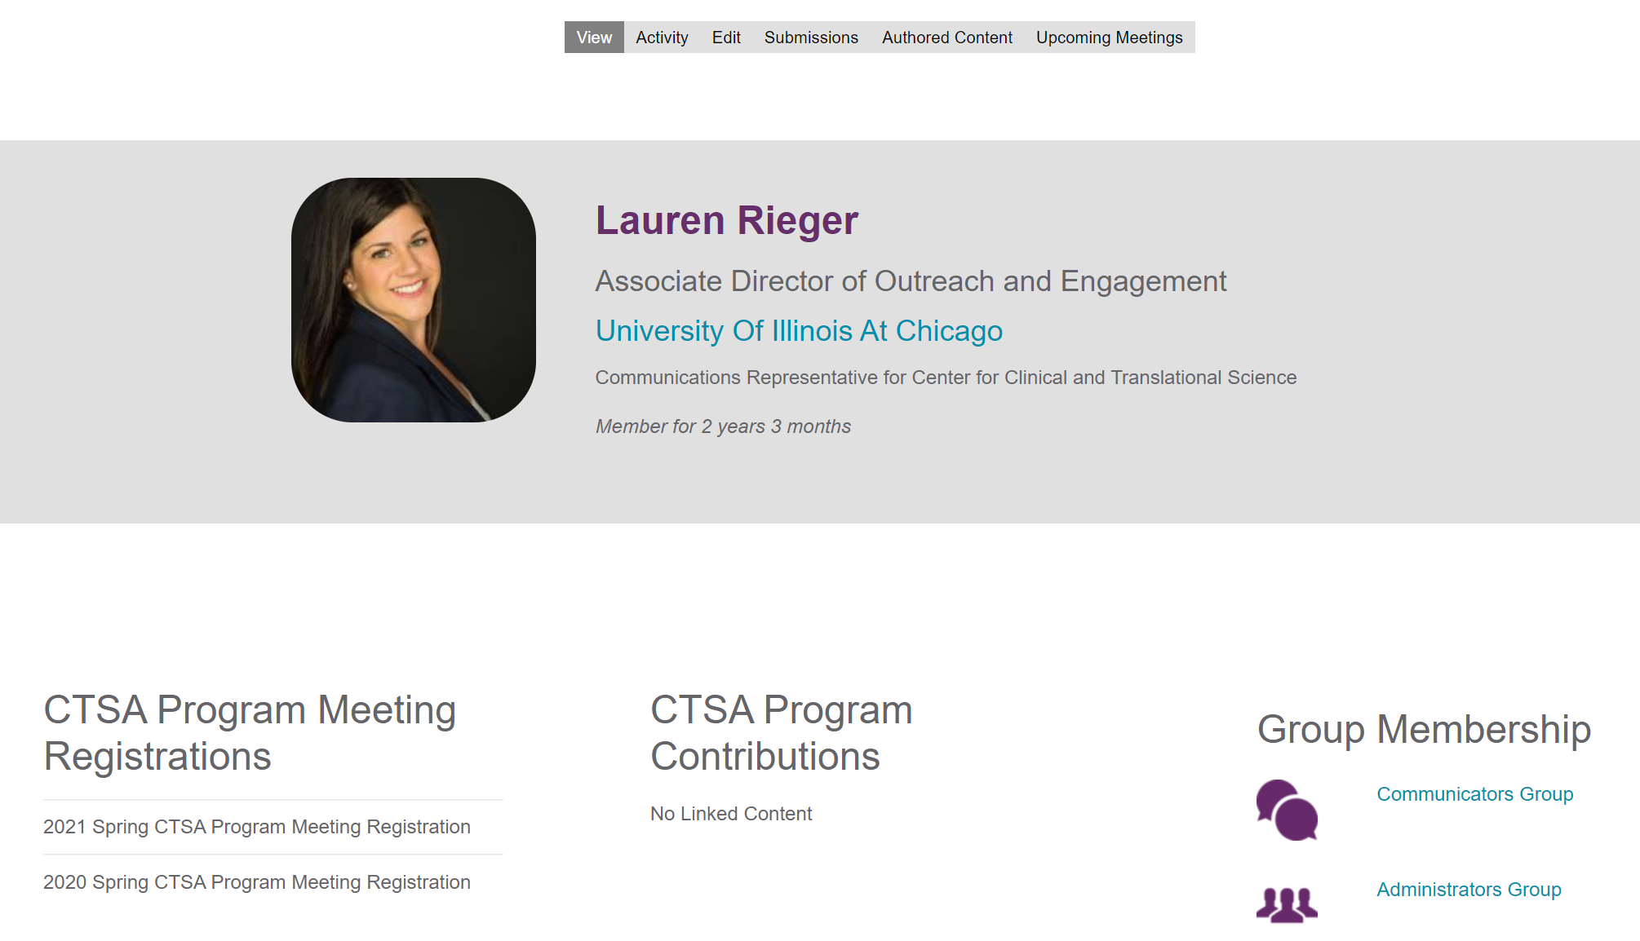
Your CLIC Account

Slide 13
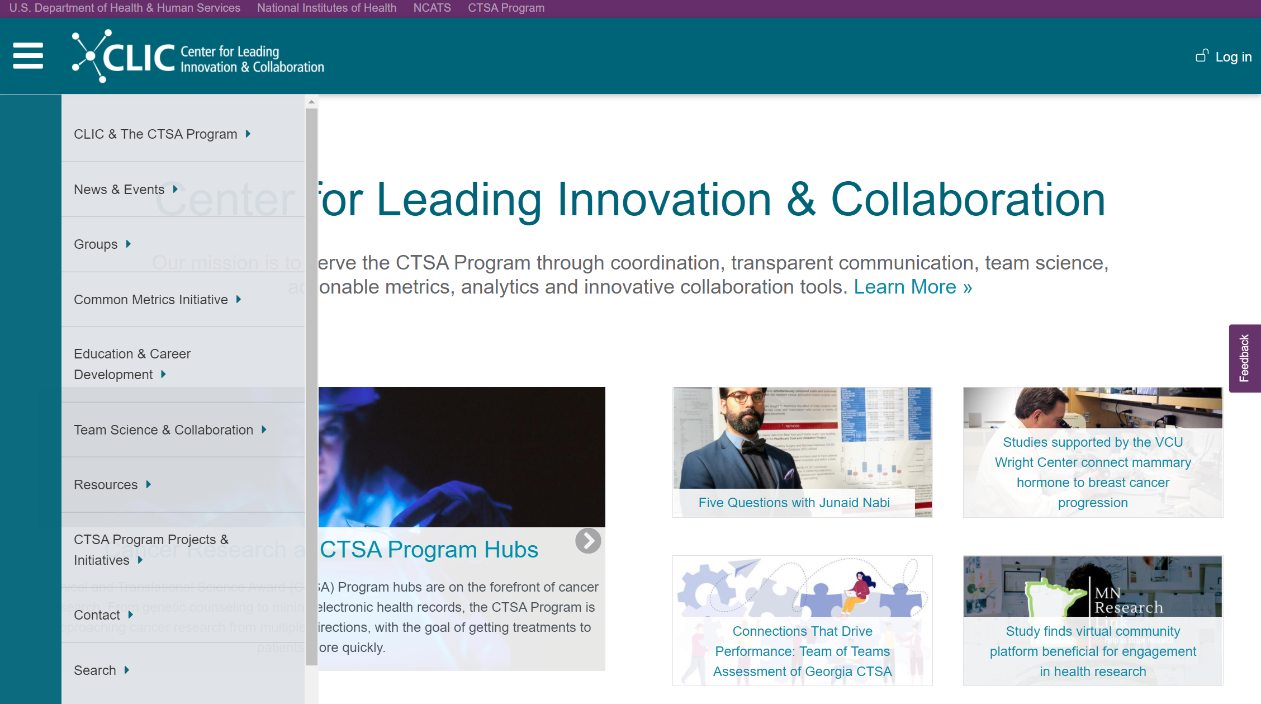
Main Menu: Overview
Notes:
News & Events
GROUPS*
Education & Career Development *Career Development Community
Team Science & Collaboration: Synergy papers & Un-Meetings
Resources: primarily contributions from other CTSAs that may inform new project/program development.

Slide 14
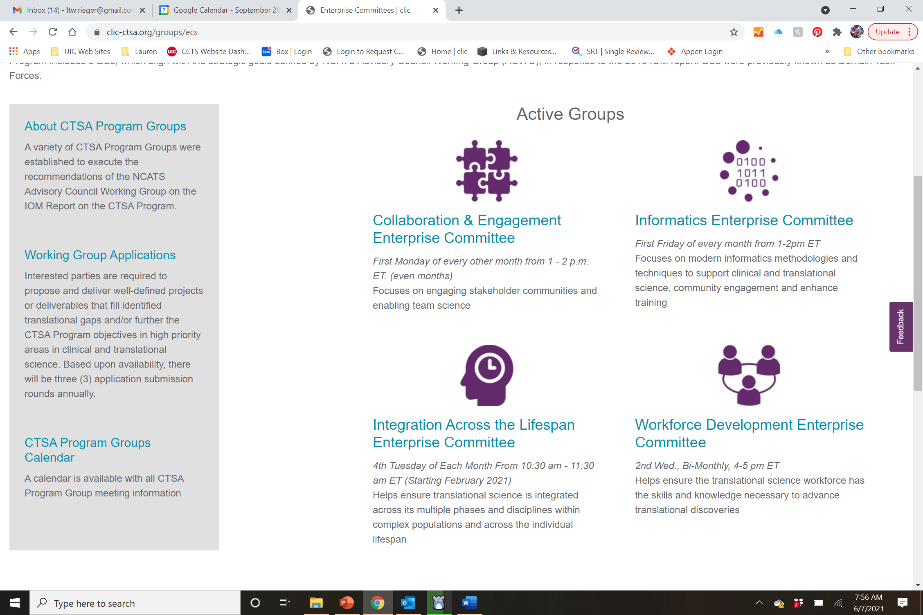
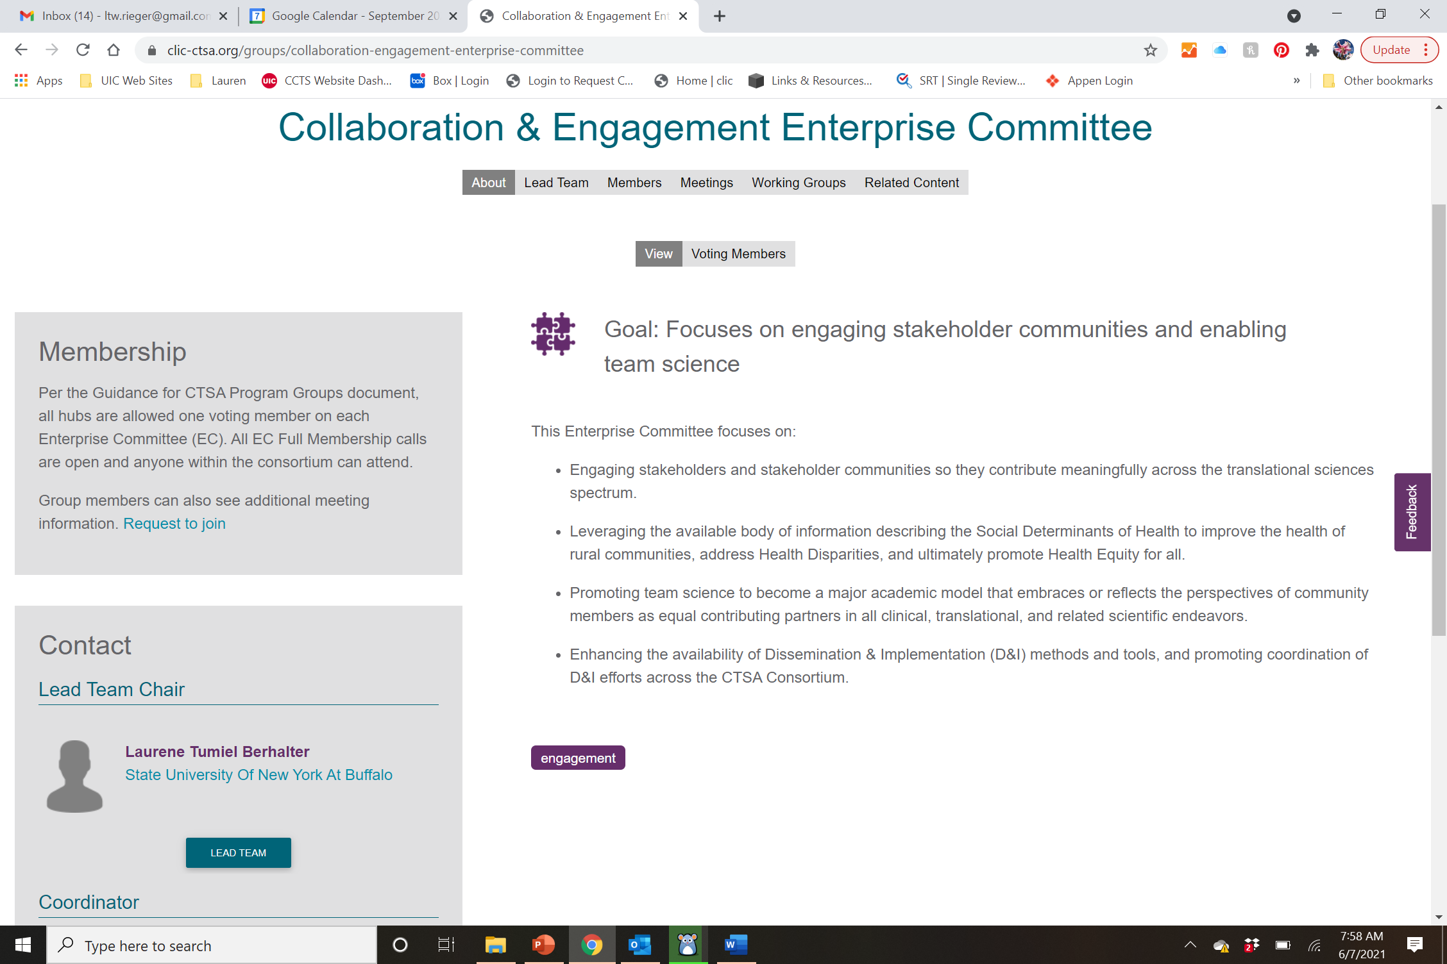
Joining Groups

Slide 15
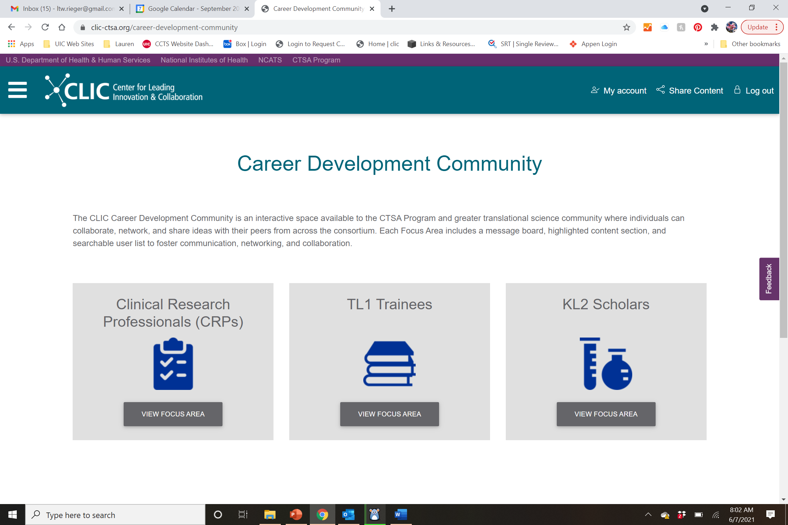
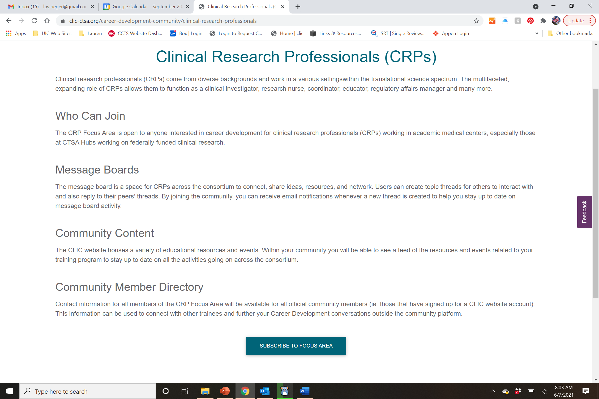
New: Career Development Community

Slide 16
Updates & Announcements

Slide 17
University Travel
University sponsored travel requires submission of a request form:
COVID-19 University Travel Request Authorization Form
Form should be submitted no more than 3 months from event, but no less than 1 month.
Required for domestic and international travel –but not in-state travel.
Policy is subject to change based upon developments in state, local, and federal guidance.
Conditional approval may be granted upon initial review if more than 4 weeks from event. A confirmation review will occur at the 4 week mark with final approval granted based upon conditions at that time.
Pre-travel counseling must be scheduled with UIC Contact Tracing at the 2 week mark. Includes required submission of a safety plan outline.
Employees may be required to quarantine upon return.
For additional information visit: https://vcha.uic.edu/about/vcha-initiatives/covid-19-university-travel-request-authorization-form/
Questions?

Slide 18
CCTS Return to Campus
We are preparing a two phased transition plan
Phase 1: Starts 9/7/2021
Employees should return to campus 2-3 per weeks
Social distancing, masking and testing requirements as required by campus
Plan for staggered schedules among core employees
Updated telecommuting agreement required
Core plans due by July 9th, 2021
Phase 2: Starts 1/1/2022
Full return to campus for all employees
Telecommuting agreements require justification and review. Approval based on employee’s position, core operations and need.
All plans are subject to change based on guidance from Campus.
Questions?

Slide 19
Announcements
CATS Program: New KL2 Scholar & CATS Affiliates
KL2 Scholar:
Elmira Jalilian, PhD Opthalmology and Visual Sciences, UIC College of Medicine Chicago Mesenchymal stem cells and their secreted factors "exosomes" for treatment of diabetic corneal neuropathy
Affiliates:
Kristine Zimmermann, PhD, MPH
Family and Community Medicine, College of Medicine Rockford
Promoting Physical Activity during Pregnancy in Rural Illinois Women
Ashley Hughes, PhD Biomedical and Health Information Sciences, College of Applied Health Sciences
My-CANCER-Roadmap
Steven Kregel, PhD, MS Pathology, UIC College of Medicine Chicago Mechanistic investigation of androgen receptor oncogenic function despite antagonism during late-state prostate cancer
Questions?

Slide 20
Additional Comments
or Questions?

